Slide 1

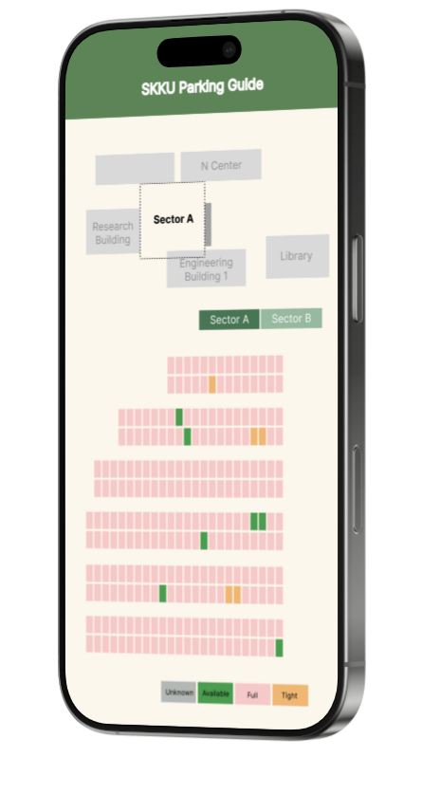
SKKU Parking Guide
실시간 주차 자리 정보 알림 앱
캡스톤프로젝트 Team I-dle
김세헌
김찬영
노하연
박인찬

Slide 2




Contents
1
2
3
4
Background
Problem
statement
Proposed
approach
Planning with
role assignment

Slide 3
Background
60%
90%
Drivers Stressed by Parking
Drivers wasting time on Parking

Slide 4
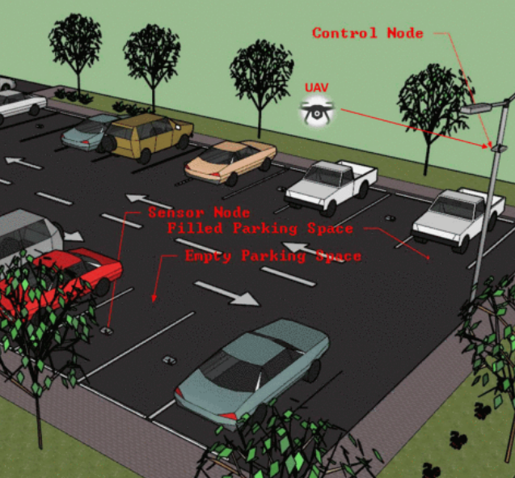
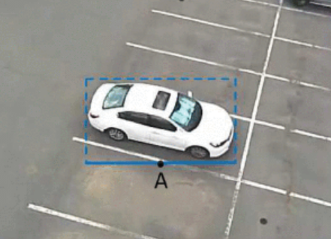
Background
Related works
Smart Parking Management Using UAVs
Parking Space Detection Using YOLOv5

Slide 5
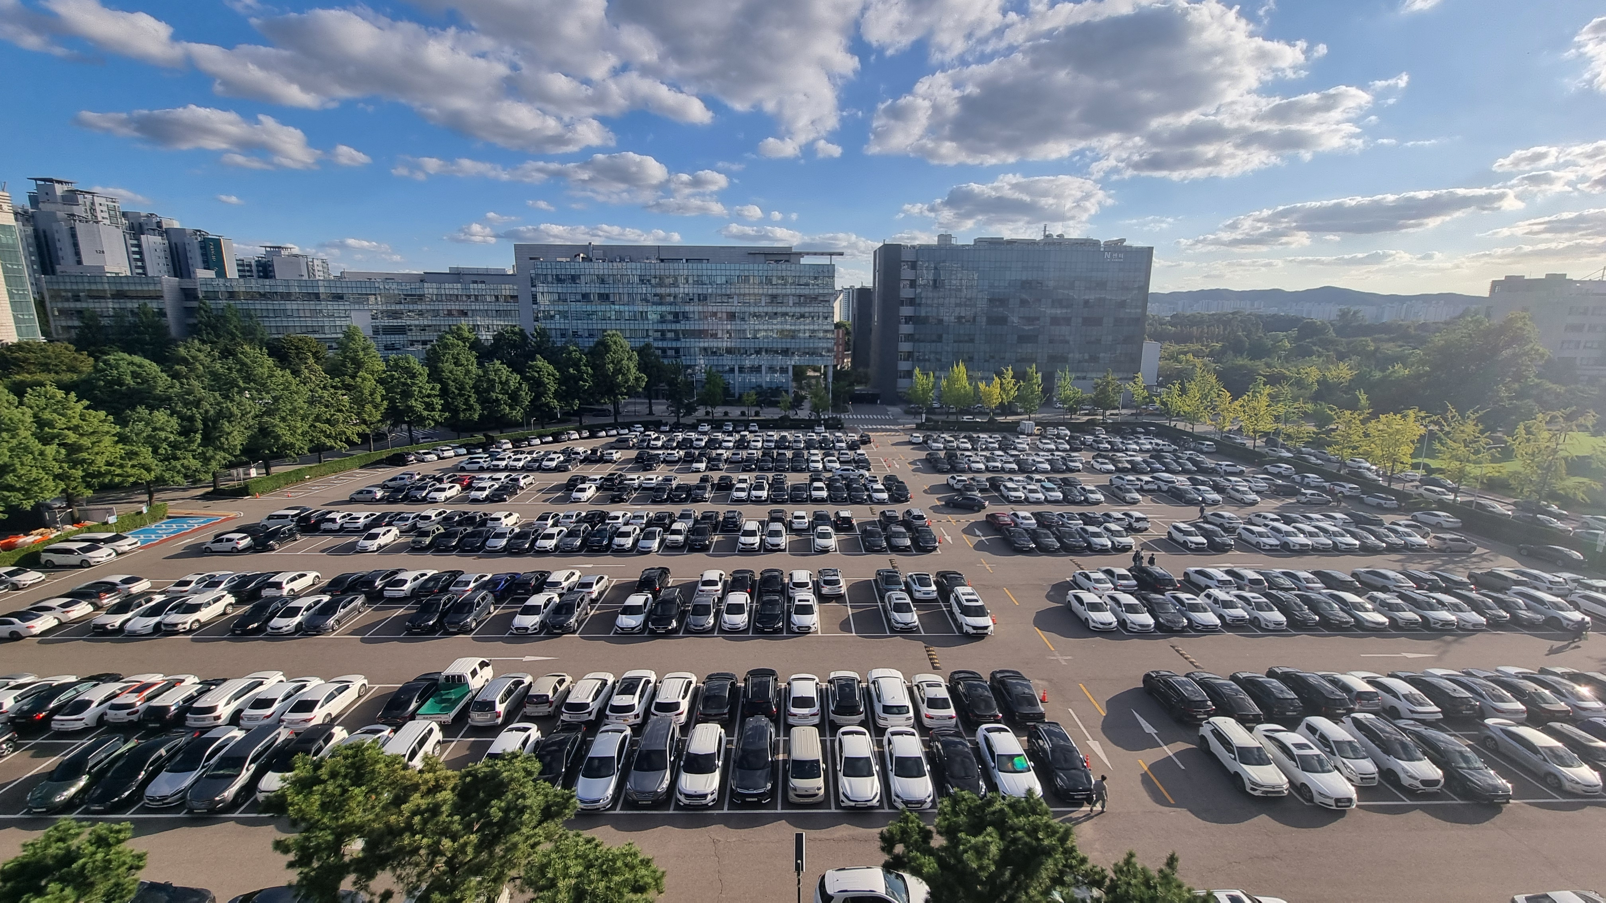

Problem statement
??

Slide 6




Proposed Solution
Bounding box center x
Bounding box center y
Bounding box width
Bounding box height
label
1. Capture the parking lot in real-time
2. Preprocess the image data and send it to trained model
3. Send the predicted bounding boxes information and labels to the database
4. Display of Abstracted Results on Mobile Application

Slide 7
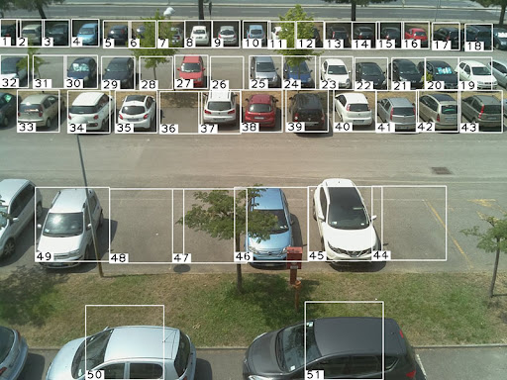
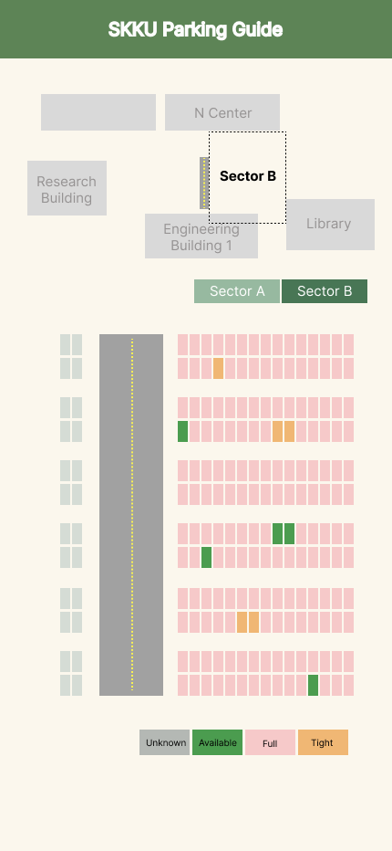
Proposed Solution
Too tight!
Multiple
Camer System
Additional Function

Slide 8
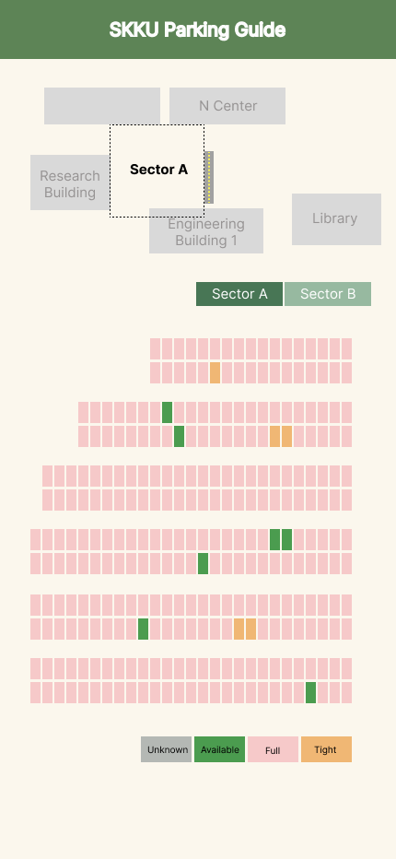
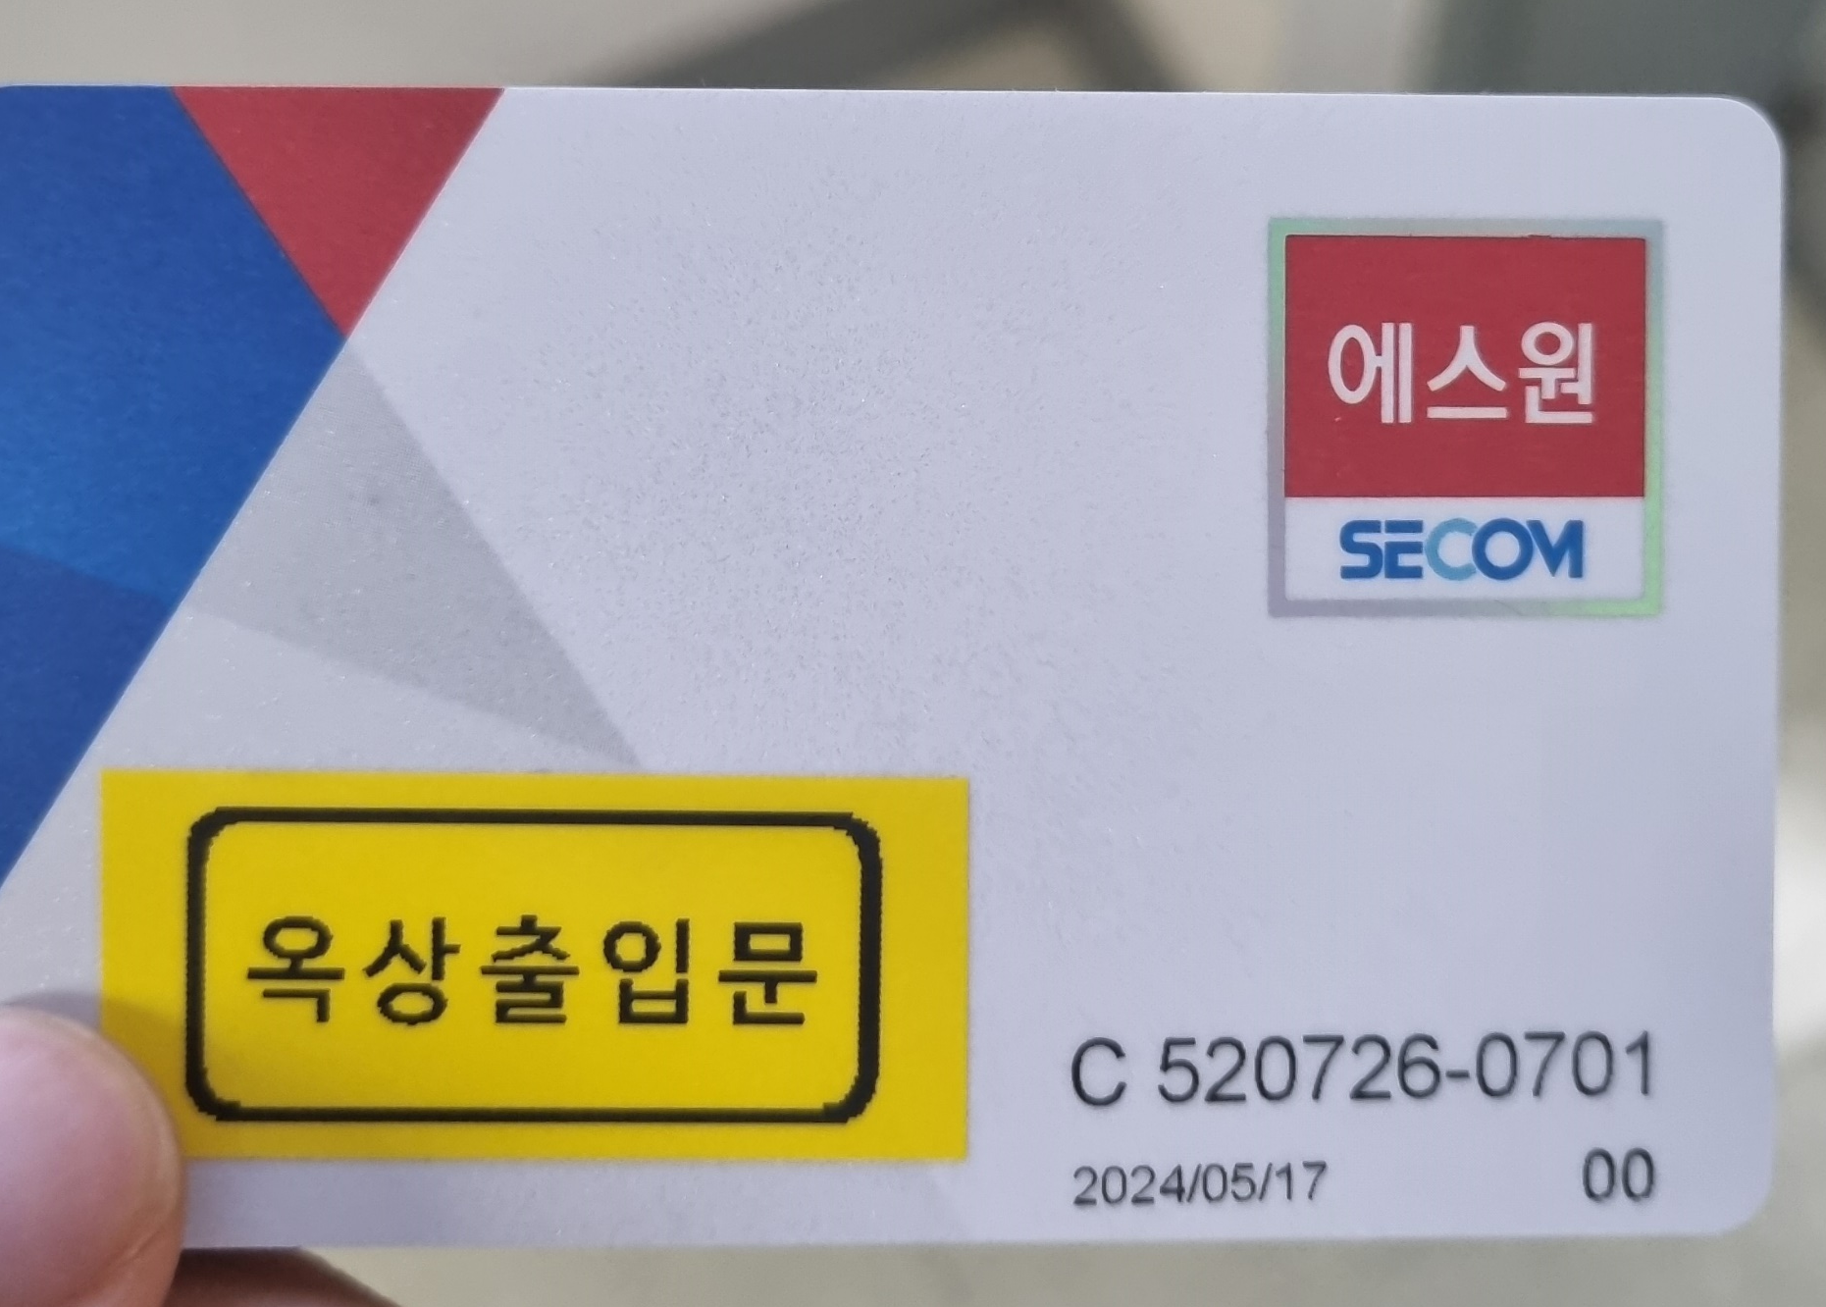
Proposed Solution
Get permission

Slide 9





Proposed Solution

Slide 10
Role assignment
Kim Seheon : Database, Application Design
Kim Hyeongjin : Application Design, Architecture Design
Noh Hayeon : Vision processing, Communication
Park Inchan : Vision processing, Communication

Slide 11
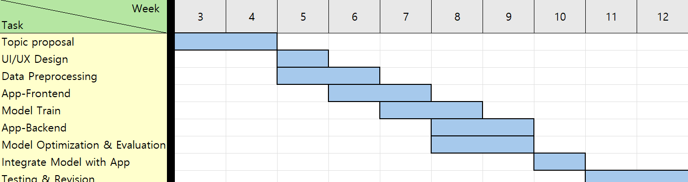
Plan
(Week)

Slide 12
Thank you

